Slide 2

Recurrent Neural Network
UNIT-3 INTRODUCTION
UNIT-4

Slide 3
UNIT-4 Recurrent Neural Network
Why use sequence models?
Recurrent Neural Network Model,
Notation,
Back-propagation through time (BTT),
Different types of RNNs,
Language model and sequence generation,
Sampling novel sequences,
Vanishing gradients with RNNs,
Gated Recurrent Unit (GRU),
Long Short-Term Memory (LSTM),
Bidirectional RNN,
Deep RNNs

Slide 4
UNIT-4 Sequence Models
Sequence Models have been motivated by the analysis of sequential data such text sentences, time-series and other discrete sequences data.
These models are especially designed to handle sequential information while Convolutional Neural Network are more adapted for process spatial information.
The key point for sequence models is that the data we are processing are not anymore independently and identically distributed (i.i.d.) samples and the data carry some dependency due to the sequential order of the data.
Sequence Models is very popular for speech recognition, voice recognition, time series prediction, and natural language processing.

Slide 5
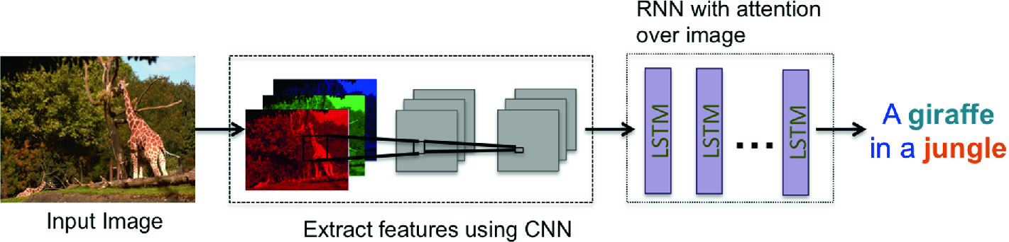
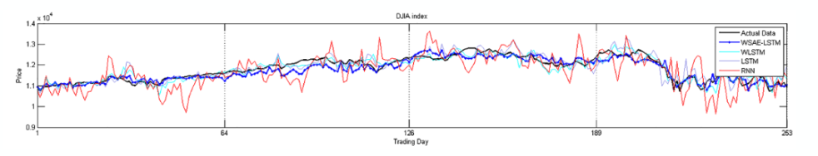
UNIT-4 Application of Sequence Data
Image Captioning: caption an image by analyzing the present action
Time Series: prediction time series problem, e.g., stock market predictions

Slide 6
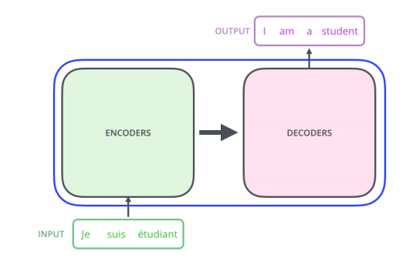
UNIT-4 Application of Sequence Data
Natural Language Processing: Text mining and Sentiment (e.g., Learning word vectors for sentiment analysis)
Machine Translation: Given an input in one language use sequence models to translate the input into different languages as output. Here a recent survey

Slide 7
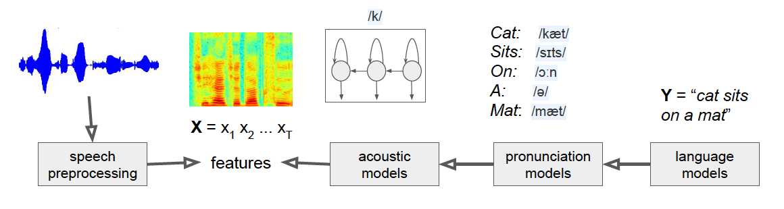
UNIT-4 Application of Sequence Data
Speech recognition: Deep Recurrent Neural network for speech recognition
Music generation generating classical music using recurrent neural networks

Slide 8
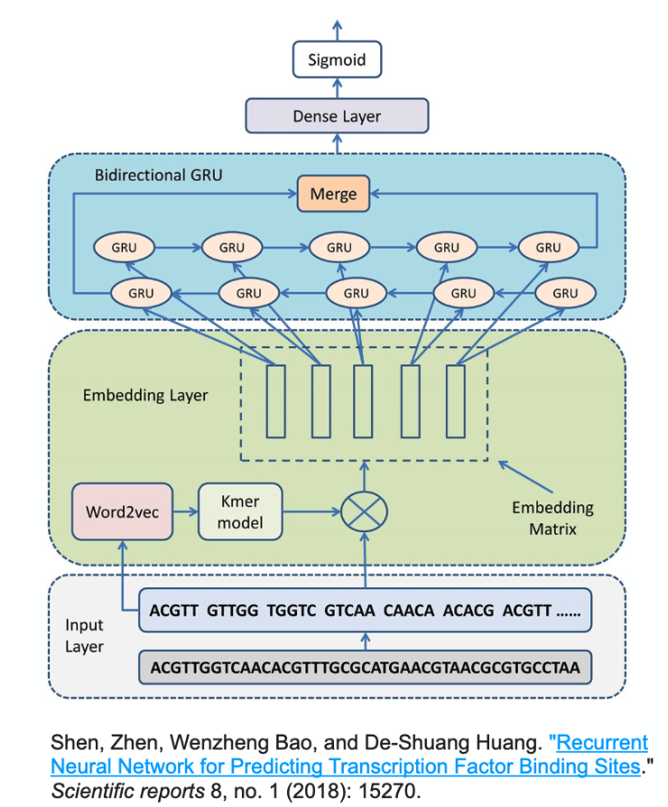
UNIT-4 Application of Sequence Data
DNA sequence analysis: Recurrent Neural Network for Predicting Transcription Factor Binding Sites

Slide 9
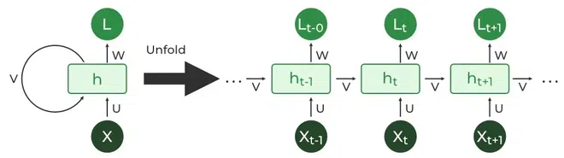
UNIT-4 Recurrent Neural network
RNN is especially designed to deal with sequential data which is not identically distributed .
RNN can tackle the following challenges from sequence data:
to deal with variable-length sequences
to maintain sequence order
to keep track of long-term dependencies
to share parameters across the sequence

Slide 10
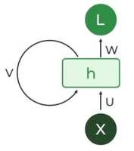
UNIT-4 Recurrent Neural network
Recurrent Unit
The fundamental processing unit in RNN is a Recurrent Unit.
Recurrent units hold a hidden state that maintains information about previous inputs in a sequence.
These units can “remember” information from prior steps by feeding back their hidden state.
This mechanism allows RNNs to capture dependencies across time.

Slide 11
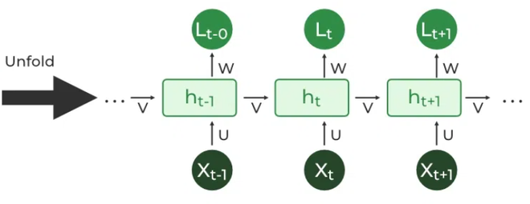
UNIT-4 Recurrent Neural network
2. RNN Unfolding
RNN unfolding or unrolling is the process of expanding the recurrent structure over time steps.
During unfolding each step of the sequence is represented as a separate layer in a series illustrating how information flows across each time step.
This unrolling enables backpropagation through time (BPTT) a learning process where errors are propagated across time steps to adjust the network’s weights enhancing the RNN’s ability to learn dependencies within sequential data.

Slide 12
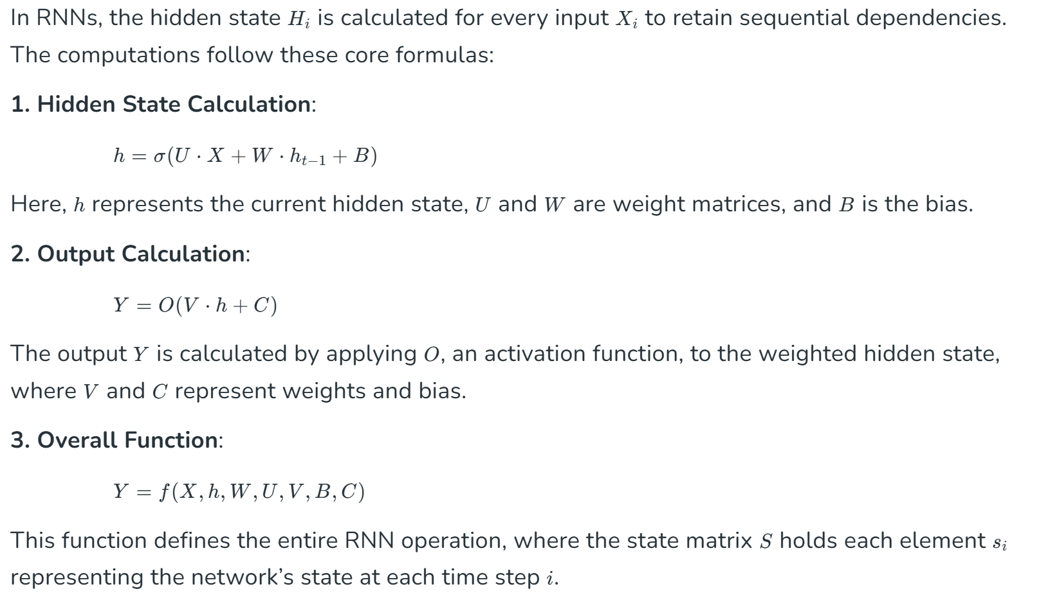
UNIT-4 Architecture of Recurrent Neural network

Slide 13
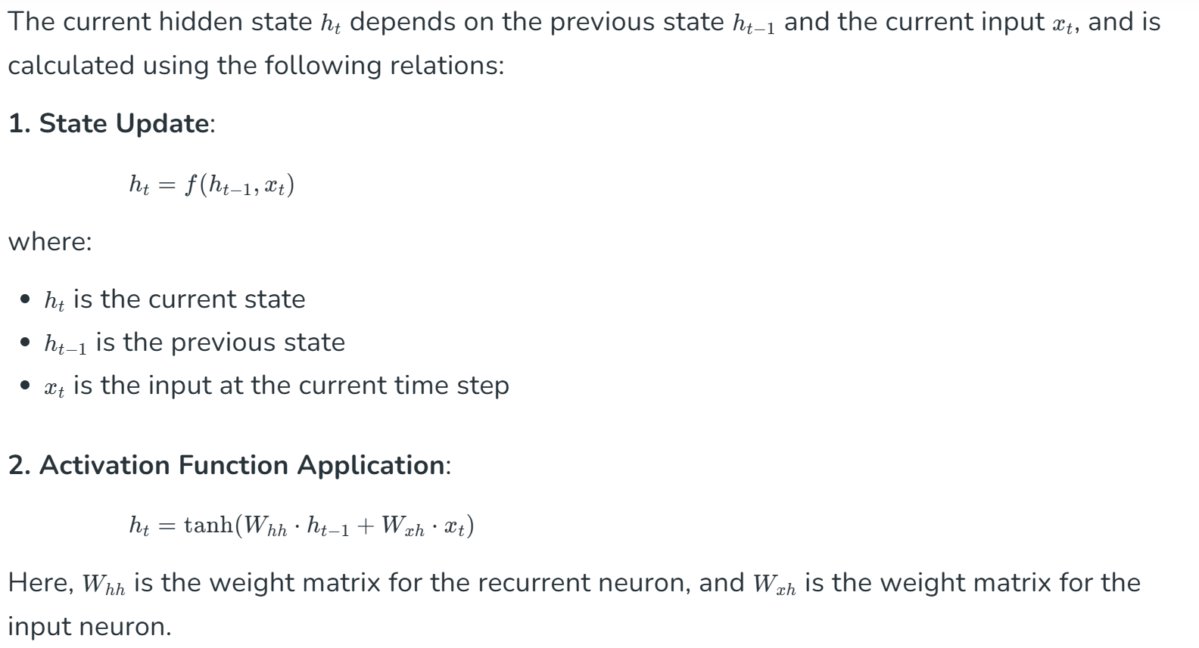
UNIT-4 Updating the Hidden State in RNNs

Slide 14
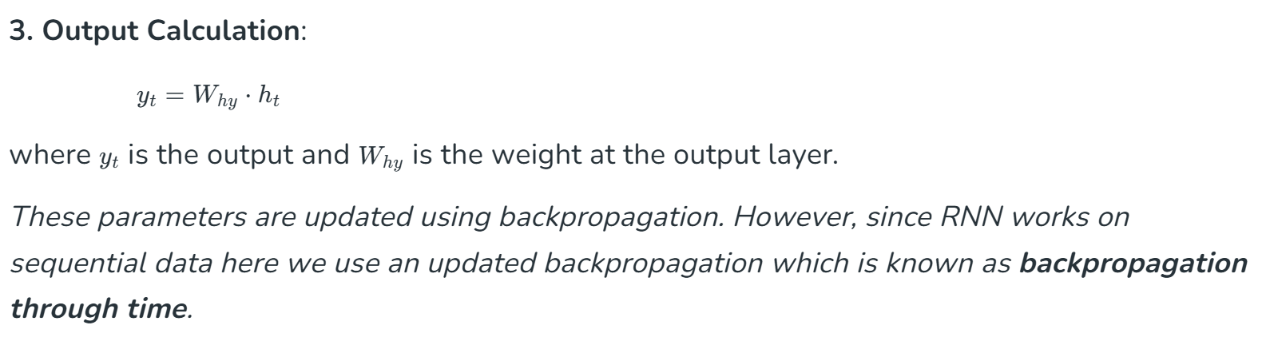
UNIT-4 Updating the Hidden State in RNNs

Slide 15
UNIT-4 Back Propagation through time – RNN
Backpropagation Through Time (BPTT) is an extension of the standard backpropagation algorithm used to train Recurrent Neural Networks (RNNs).
Since RNNs have loops, allowing them to retain information over time, their training requires special handling of the temporal (sequential) dimension.
Backpropagation Through Time is a method to compute gradients for RNNs by unrolling the network through time and then applying standard backpropagation.

Slide 16
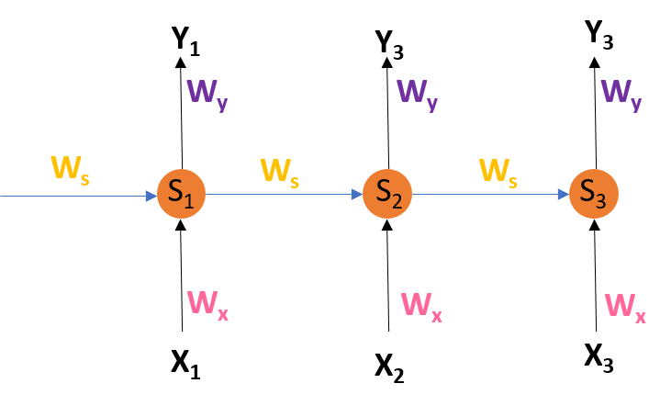
UNIT-4 Introduction of BPTT
Introduction
Recurrent Neural Networks are those networks that deal with sequential data.
They predict outputs using not only the current inputs but also by taking into consideration those that occurred before it.
In other words, the current output depends on current output as well as a memory element (which takes into account the past inputs).
For training such networks, we use good old backpropagation but with a slight twist.
We don’t independently train the system at a specific time “t”.
We train it at a specific time “t” as well as all that has happened before time “t” like t-1, t-2, t-3. Consider the following representation of a RNN:.

Slide 17
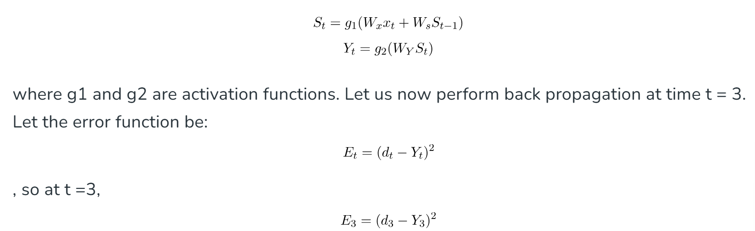
UNIT-4 Introduction of BPTT
S1, S2, S3 are the hidden states or memory units at time t1, t2, t3 respectively, and Ws is the weight matrix associated with it.
X1, X2, X3 are the inputs at time t1, t2, t3 respectively, and Wx is the weight matrix associated with it.
Y1, Y2, Y3 are the outputs at time t1, t2, t3 respectively, and Wy is the weight matrix associated with it.
For any time, t, we have the following two equations:

Slide 18
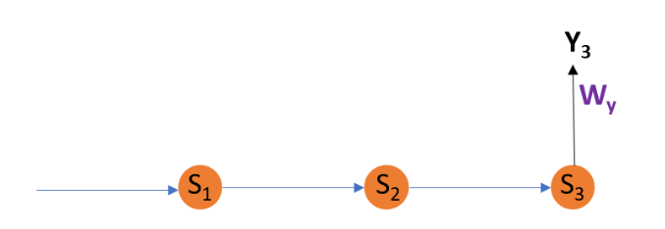
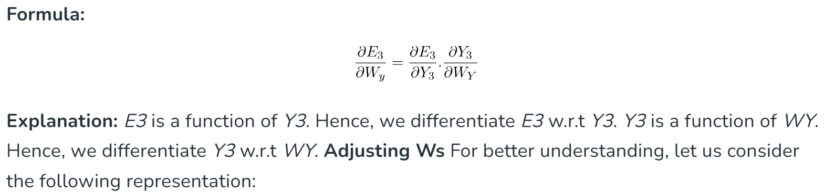
UNIT-4 Introduction of BPTT
We are using the squared error here, where d3 is the desired output at time t = 3.
To perform back propagation, we have to adjust the weights associated with inputs, the memory units and the outputs.
Adjusting Wy For better understanding, let us consider the following representation:

Slide 19
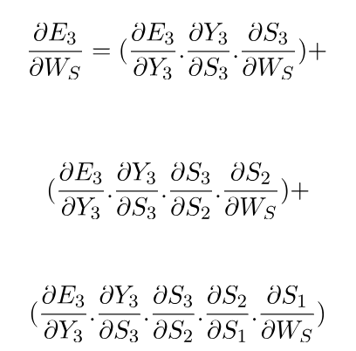
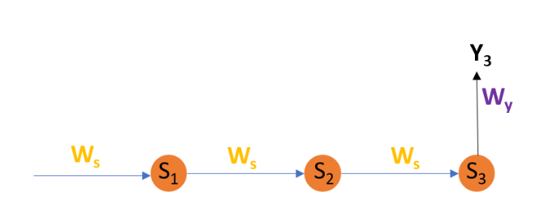
UNIT-4 Introduction of BPTT
https://www.geeksforgeeks.org/ml-back-propagation-through-time/

Slide 20
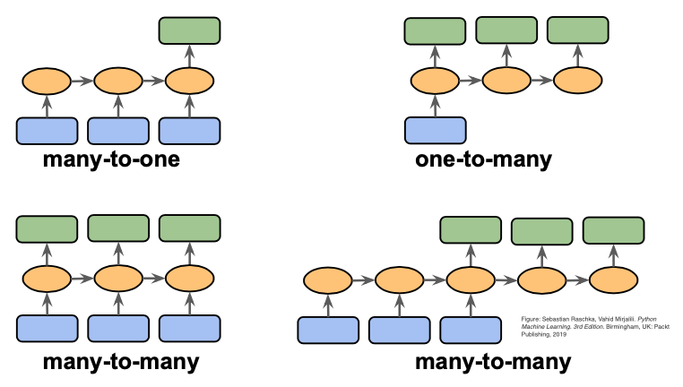
Different types of Sequence Modeling Tasks
many-to-one: Sentiment Classification, action prediction (sequence of video -> action class)
one-to-many: Image captioning (image -> sequence of words)
many-to-many: Video Captioning (Sequance of video frames -> Caption)
many-to-many: Video Classification on frame level

Slide 21
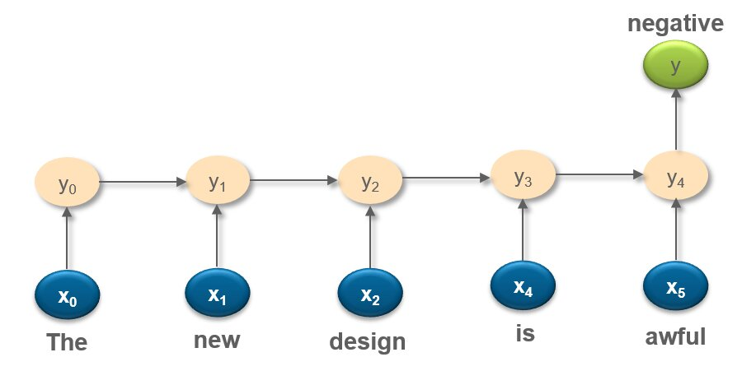
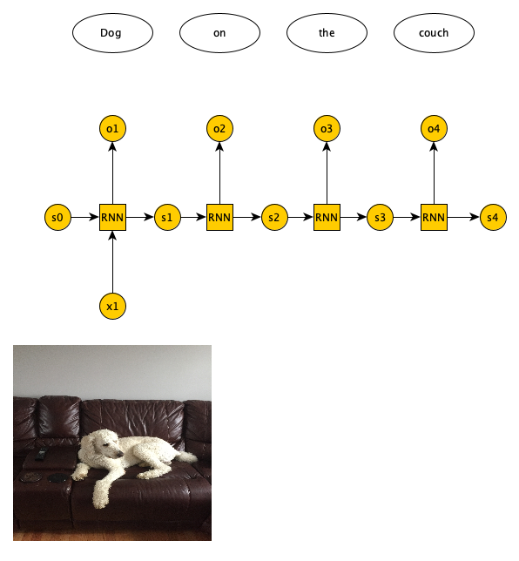
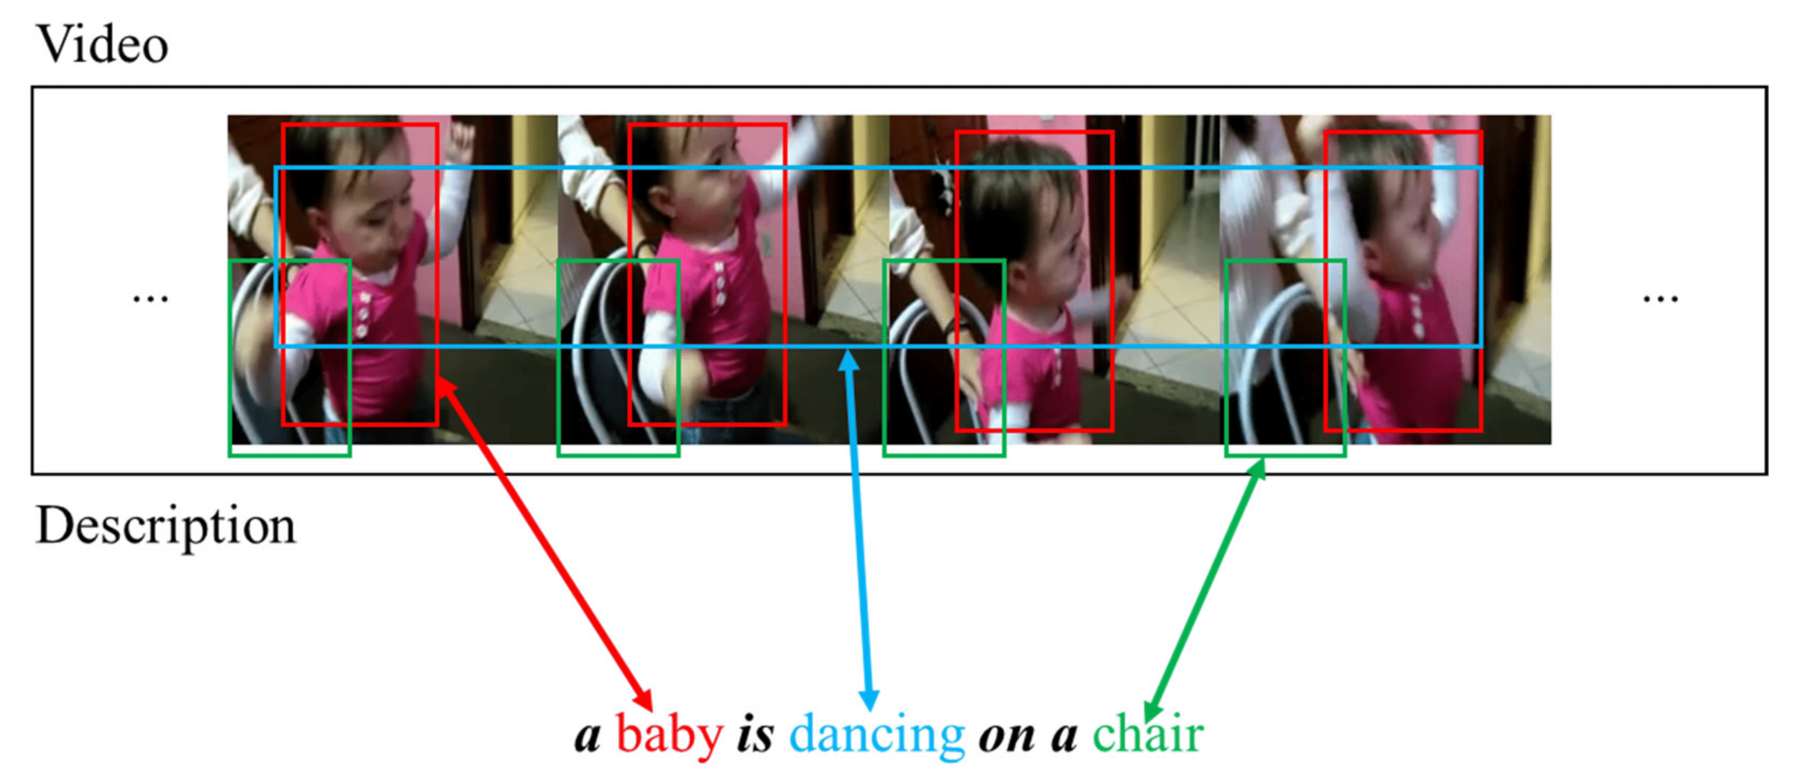
Identify types of RNN ?

Slide 22
Language model and sequence generation
A Language Model is a type of model in Natural Language Processing (NLP) that predicts the likelihood of a sequence of words. It helps machines understand, generate, or complete human language in a meaningful way.
Language modeling involves using statistical, probabilistic, and machine learning techniques to estimate the likelihood of a sequence of words appearing in a sentence. These models analyze large text corpora to learn patterns and make accurate word predictions.
Language models determine word probability by analyzing text data.
They interpret this data by feeding it through an algorithm that establishes rules for context in natural language.
Then, the model applies these rules in language tasks to accurately predict or produce new sentences.
The model essentially learns the features and characteristics of basic language and uses those features to understand new phrases.

Slide 23
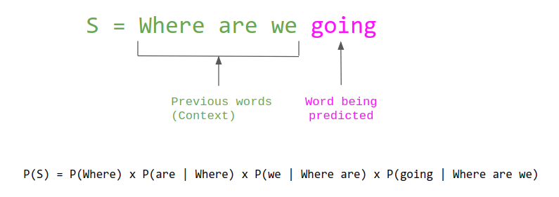
Language model and sequence generation
More complex language models are better at NLP tasks, because language itself is extremely complex and always evolving.
https://www.kaggle.com/code/quadeer15sh/introduction-to-language-modelling-using-rnns

Slide 24
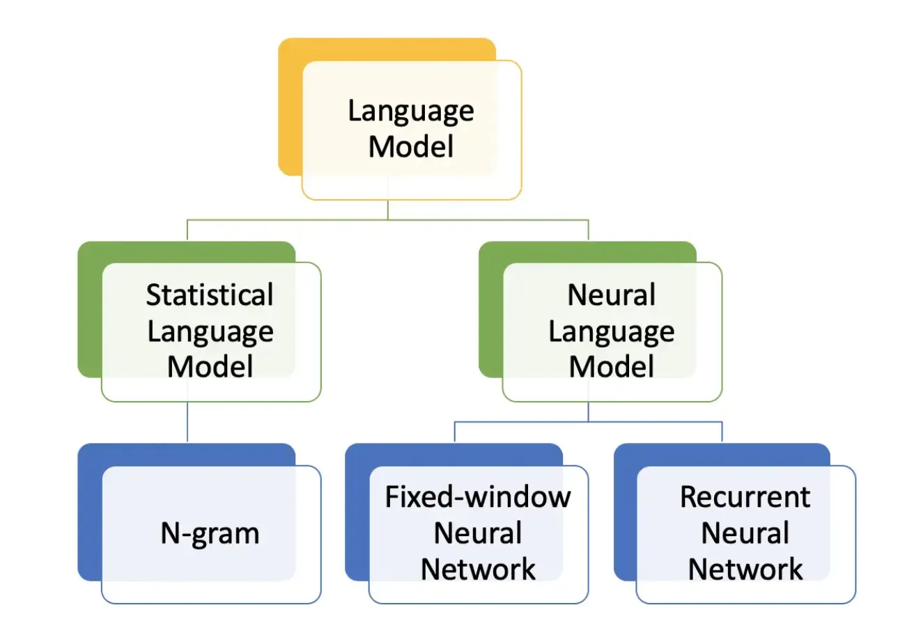
Type of Language model

Slide 25
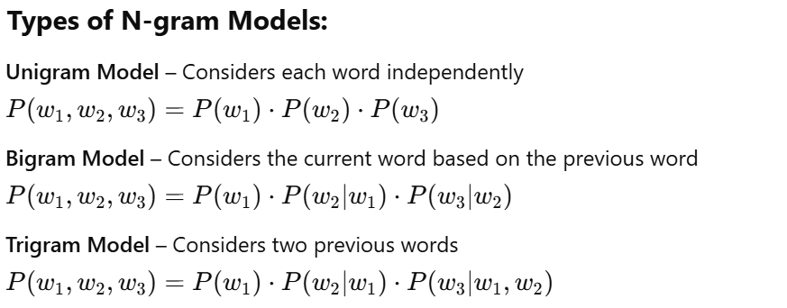
Statistical Language Model
A Statistical Language Model is a mathematical model that assigns probabilities to word sequences based on their frequency in a corpus of text.
It captures how likely it is that a given sequence of words will occur.
Statistical language models rely on the probability of word sequences. The basic assumption is that the probability of a word depends on the previous few words.
This is known as the Markov assumption, which is simplified in n-gram models.

Slide 26
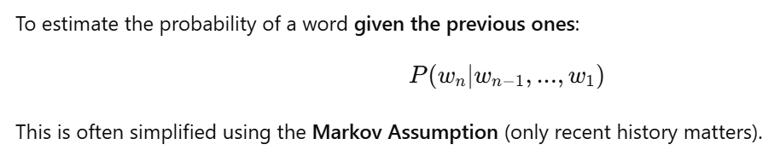
Statistical Language Model
N-gram
An N-gram is a contiguous sequence of n words from a given text or speech.
It's a core concept in Statistical Language Modeling, used to predict the next word in a sequence based on the previous n−1 words.
In general:
Unigram models assume each word is independent.
Bigram models look at 1 previous word.
Trigram models look at 2 previous words, and so on.
Text: "I enjoy reading books"
Unigrams: [I], [enjoy], [reading], [books]
Bigrams: [I enjoy], [enjoy reading], [reading books]
Trigrams: [I enjoy reading], [enjoy reading books]

Slide 27
Statistical Language Model
Limitations of N-gram models:
N-gram based language models do have a few drawbacks:
N-gram is the simplest language model and its performance is limited by its lack of complexity. Simplistic models like this one can not achieve fluency,
The higher the N, the better is the model usually. But this leads to lots of computation overhead that requires large computation power in terms of RAM.
N-grams are a sparse representation of language. This is because we build the model based on the probability of words co-occurring. It will give zero probability to all the words that are not present in the training corpus.

Slide 28
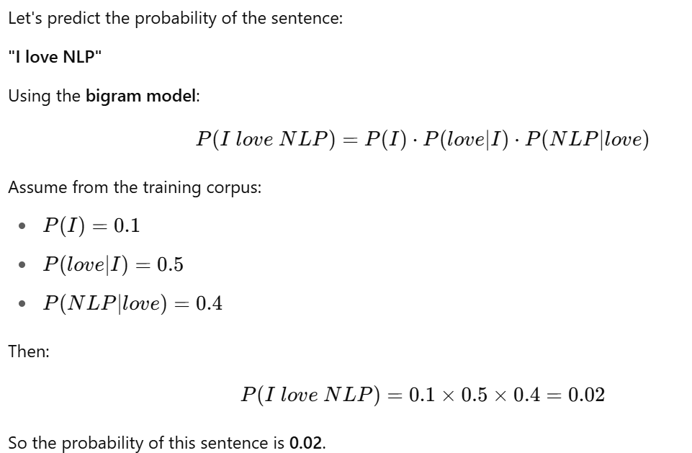
Statistical Language Model
Example: Bigram Model
https://colab.research.google.com/drive/1ZzFOncPSbYJdnIy22vtOSbzHoCTW0KBL?authuser=1

Slide 29
Statistical Language Model
Advantages of Statistical Language Models
Simple to build and interpret
Efficient for small vocabularies
Effective for short-range dependencies
Limitations
Data Sparsity: Cannot handle rare or unseen word combinations.
Limited Context: N-gram models only consider a fixed number of previous words.
Large Models: Higher-order n-grams require a lot of memory and computation.
Lack of Generalization: Can’t capture syntactic or semantic meaning.

Slide 30
Statistical Language Model
Modern Evolution
Because of the limitations of SLMs, more advanced Neural Language Models have emerged:
RNNs (Recurrent Neural Networks)
LSTMs and GRUs
Transformer-based models (like GPT, BERT)
Use Cases of Statistical Language Models
Autocomplete in keyboards
Spell checkers
Speech recognition
Early machine translation systems
OCR (Optical Character Recognition)

Slide 31
Neural Language Model
A Neural Language Model uses neural networks to learn the probability distribution of word sequences.
Unlike Statistical Language Models (like n-grams), NLMs can capture long-range dependencies, understand context, and generalize better.
Instead of relying only on word frequency, a Neural Language Model:
Embeds words into vectors (via embeddings like Word2Vec or learned weights)
Feeds sequences of these vectors into a neural network (RNN, LSTM, Transformer)
Predicts the next word by outputting a probability distribution over vocabulary

Slide 32
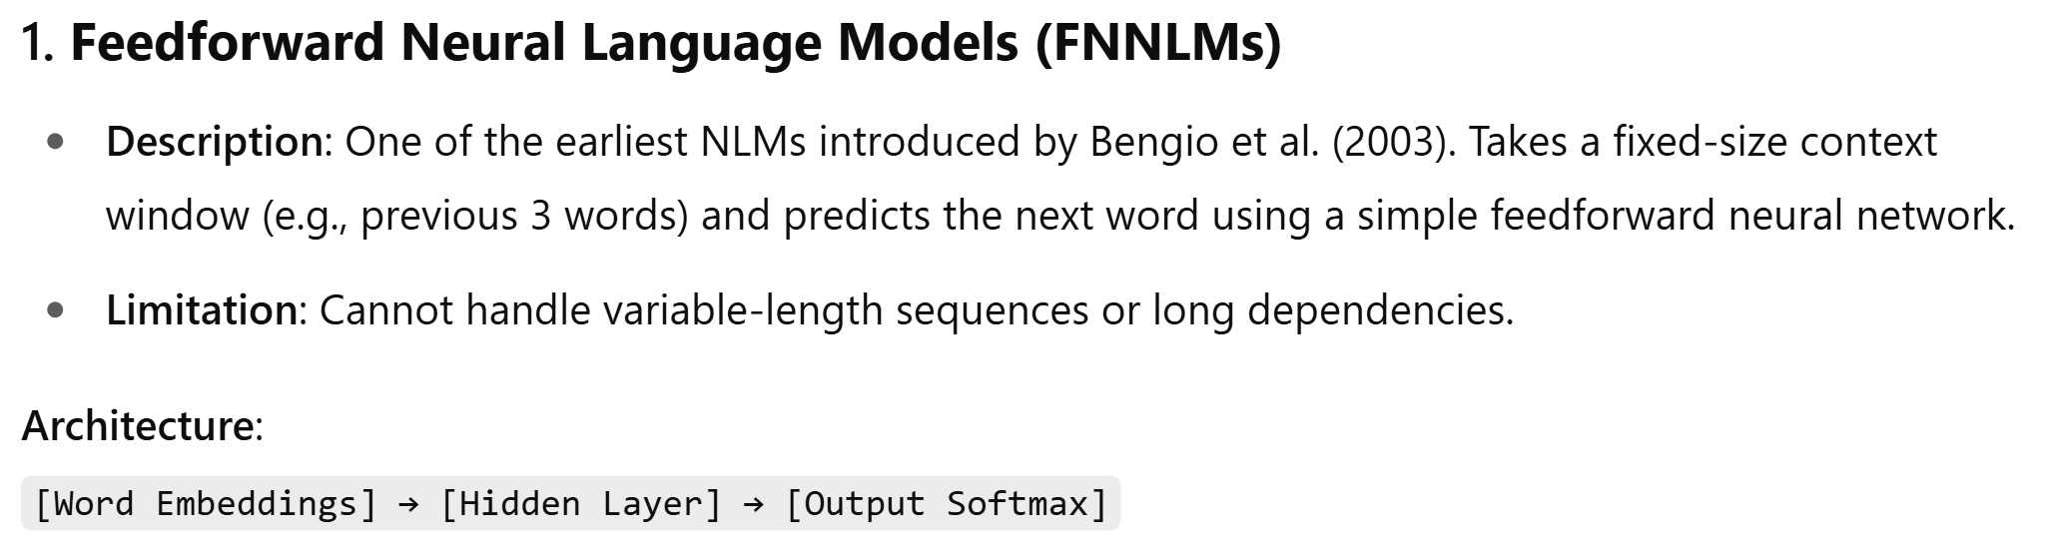
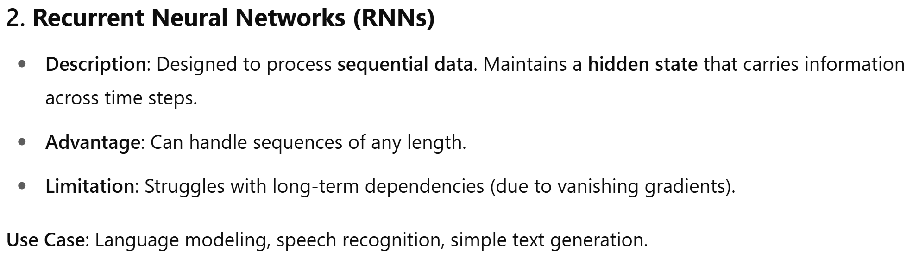
Type of Neural Language Model

Slide 33
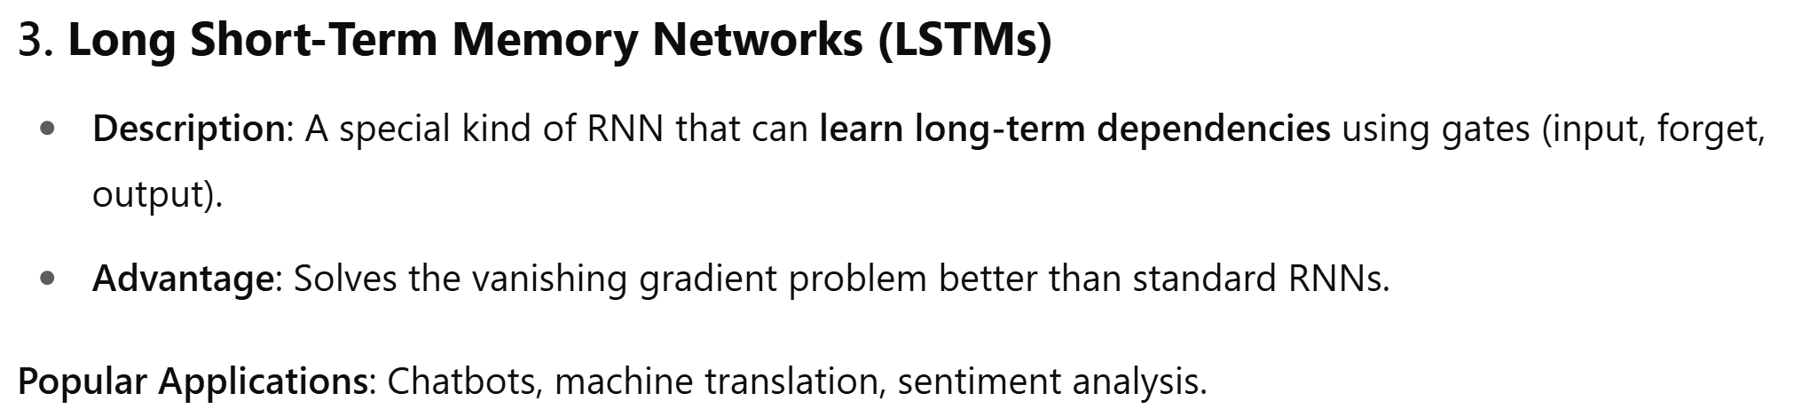
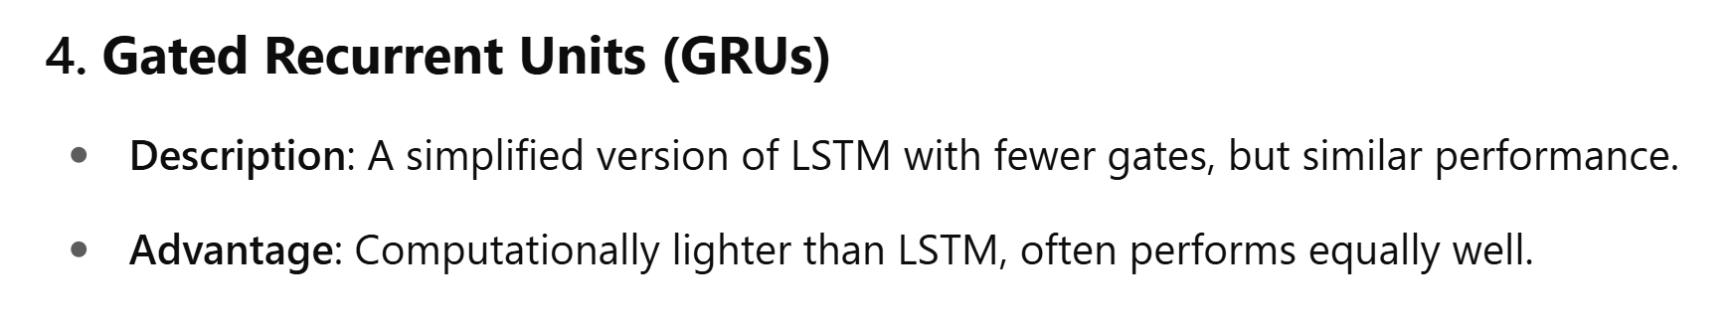
Type of Neural Language Model

Slide 34
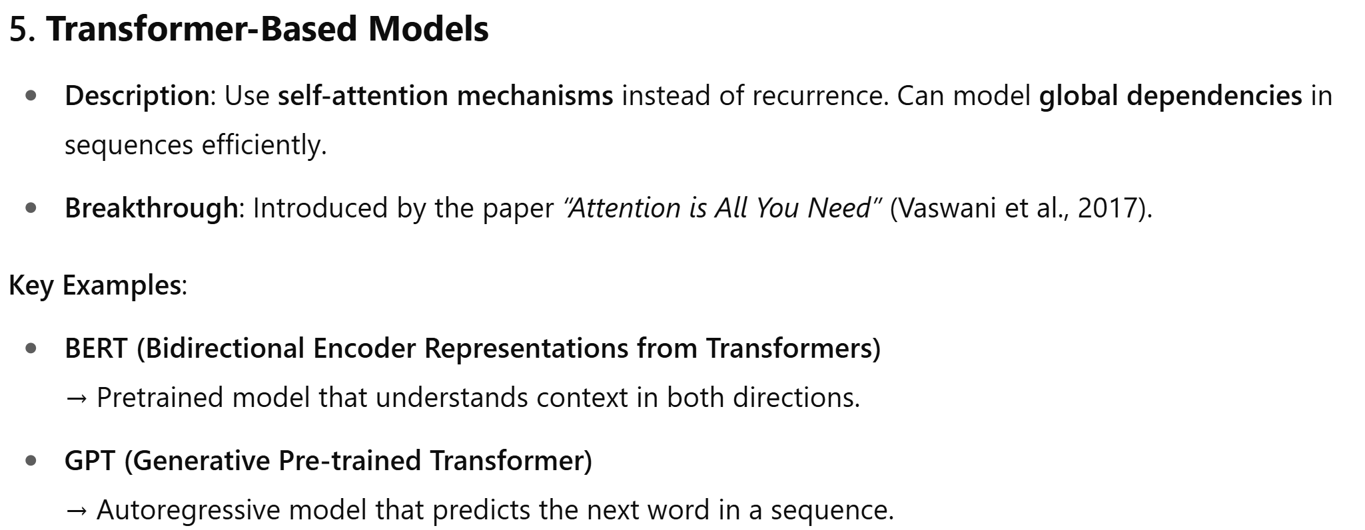
Type of Neural Language Model

Slide 35
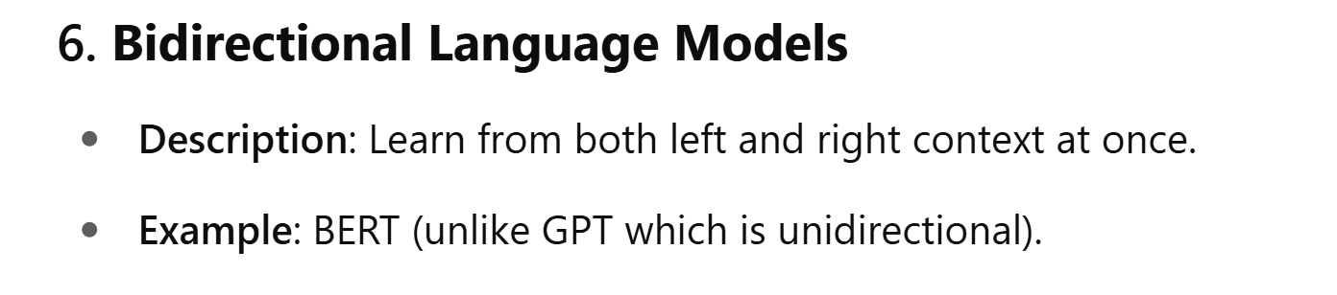
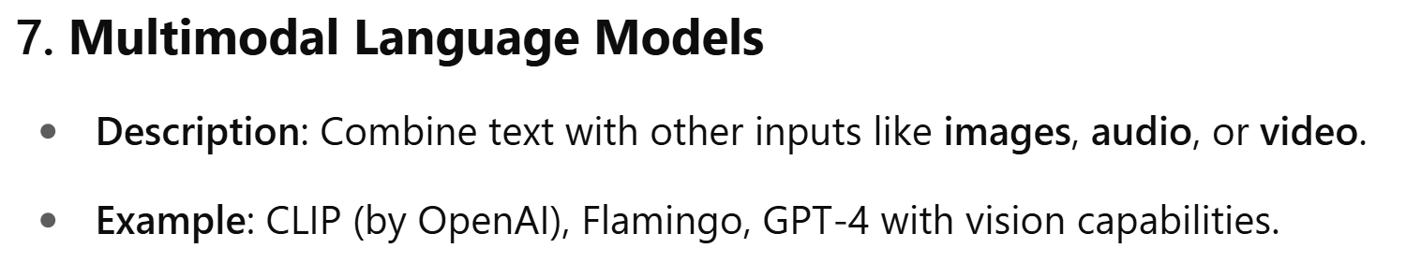
Type of Neural Language Model

Slide 36
Summary of Neural Language Models
Type | Handles Sequence? | Long-Term Dependencies | Popular Use
Feedforward NN | ❌ | ❌ | Basic language modeling
RNN | ✅ | ❌ (vanishing gradient) | Basic sequence modeling
LSTM / GRU | ✅ | ✅ | Chatbots, translation
Transformers (e.g., GPT) | ✅ (self-attention) | ✅ (very well) | Modern NLP tasks

Slide 37
Neural Language Model
Advantages of Neural Language Models
Handle long-range context better than n-grams
Use word embeddings for better semantic understanding
More accurate and generalizable
Applications
Chatbots (like ChatGPT)
Text generation (e.g., story writing)
Machine translation
Sentiment analysis
Question answering

Slide 38
Sampling Novel Sequences
Sample Novel Sequencing can refer to the task of generating or processing sequences of novel (previously unseen) text or handling new input sequences that differ from those encountered during training.
Sample Novel Sequencing in NLP typically means generating or analyzing text sequences that are novel, i.e., not present in the training data, using language models or sequence prediction algorithms.

Slide 39
Sampling Novel Sequences
Sample Novel Sequencing can refer to the task of generating or processing sequences of novel (previously unseen) text or handling new input sequences that differ from those encountered during training.
Sample Novel Sequencing in NLP typically means generating or analyzing text sequences that are novel, i.e., not present in the training data, using language models or sequence prediction algorithms.
Sampling Novel Sequences is a common technique used in generative models such as Recurrent Neural Networks (RNNs), Transformers, GANs, and VAEs, where the model generates new data (sequences) that were not explicitly present in the training set but follow the learned distribution.

Slide 40
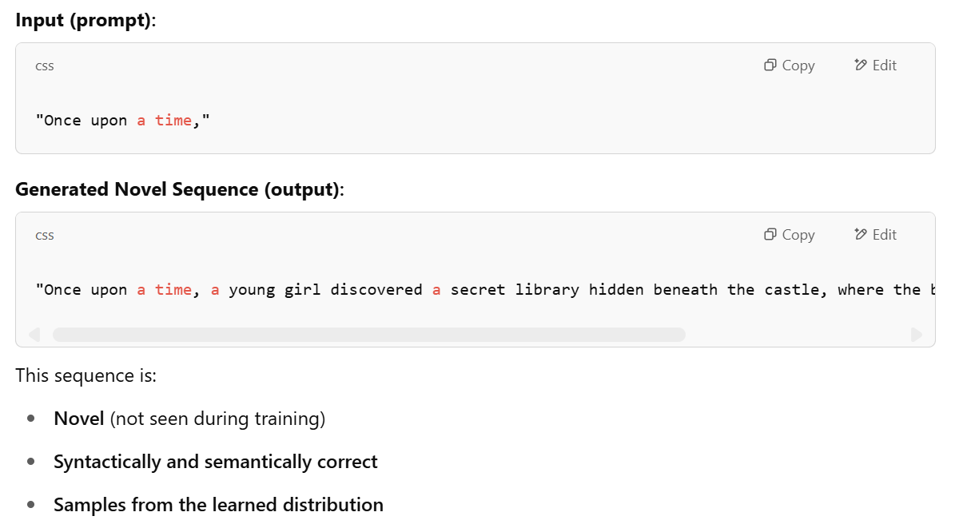
Sampling Novel Sequences in Text Generation
Model: Trained Transformer or LSTM model on a corpus of English sentences.
Sampling Method: Temperature sampling or top-k sampling from the output distribution at each time step.

Slide 41
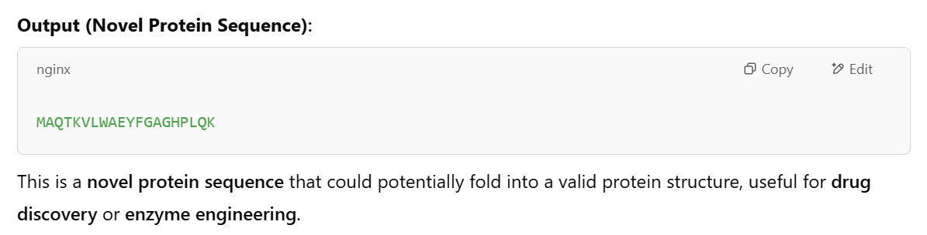
Example in Biology (e.g., Protein Design using GANs or VAEs)
Model: Trained VAE on protein sequences.
Process:
Sample from the latent space → decode into a new amino acid sequence.
https://colab.research.google.com/drive/1ZzFOncPSbYJdnIy22vtOSbzHoCTW0KBL?authuser=1#scrollTo=1Rpy9TldzbDo

Slide 42
UNIT-4 Vanishing gradients with RNNs
In an RNN, the same weights are applied across time steps. During backpropagation through time (BPTT), gradients are multiplied repeatedly by the same weight matrices.
If those weights have values less than 1, repeated multiplication leads to exponentially smaller values → gradients vanish.
Key Problem:
As the gradient shrinks:
Early layers (earlier time steps) receive almost no update.
The network fails to learn long-term dependencies in sequences.
This leads to poor performance on tasks like language modeling or time-series prediction.

Slide 43
UNIT-4 Vanishing gradients with RNNs
The vanishing gradient problem in Recurrent Neural Networks (RNNs) arises when gradients become progressively smaller as they are propagated backward through time during training, particularly for long sequences.
This makes it difficult for the model to learn long-term dependencies in the input data.
Especially, when using activation functions like sigmoid or tanh, according to several sources. The gradients can become extremely small, hindering the learning process, particularly for long sequences.

Slide 44
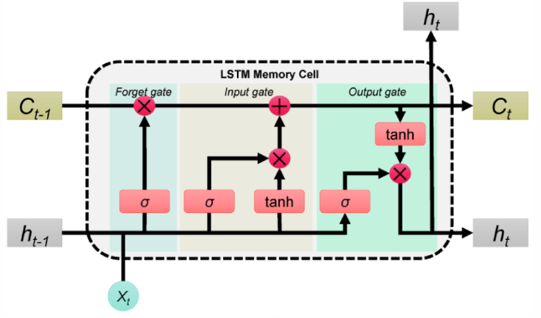
UNIT-4 Long Short-Term Memory (LSTM)
Long Short-Term Memory (LSTM) is an enhanced version of the Recurrent Neural Network (RNN).
It is designed by Hochreiter & Schmidhuber.
LSTMs can capture long-term dependencies in sequential data making them ideal for tasks like language translation, speech recognition and time series forecasting.
Unlike traditional RNNs which use a single hidden state passed through time LSTMs introduce a memory cell that holds information over extended periods addressing the challenge of learning long-term dependencies.

Slide 45
UNIT-4 Problem with Long-Term Dependencies in RNN
Recurrent Neural Networks (RNNs) are designed to handle sequential data by maintaining a hidden state that captures information from previous time steps.
However, they often face challenges in learning long-term dependencies where information from distant time steps becomes crucial for making accurate predictions for current state. This problem is known as the vanishing gradient or exploding gradient problem.
Vanishing Gradient: When training a model over time, the gradients (which help the model learn) can shrink as they pass through many steps. This makes it hard for the model to learn long-term patterns since earlier information becomes almost irrelevant.
Exploding Gradient: Sometimes, gradients can grow too large, causing instability. This makes it difficult for the model to learn properly, as the updates to the model become erratic and unpredictable.
Both of these issues make it challenging for standard RNNs to effectively capture long-term dependencies in sequential data.

Slide 46
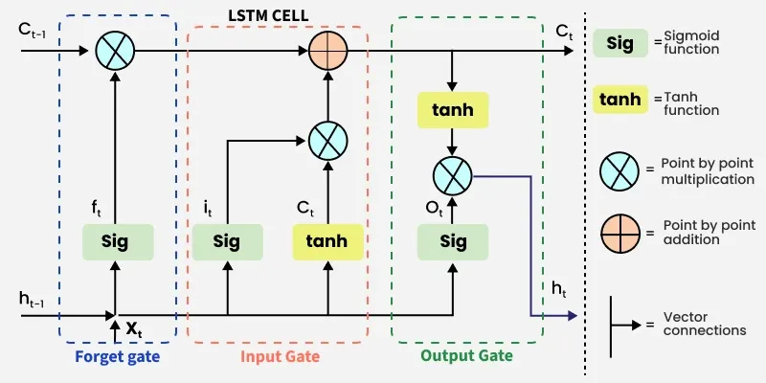
UNIT-4 LSTM Architecture

Slide 47
UNIT-4 LSTM Architecture
LSTM architectures involves the memory cell which is controlled by three gates: the input gate, the forget gate and the output gate.
These gates decide what information to add to, remove from and output from the memory cell.
Input gate: Controls what information is added to the memory cell.
Forget gate: Determines what information is removed from the memory cell.
Output gate: Controls what information is output from the memory cell.
This allows LSTM networks to selectively retain or discard information as it flows through the network which allows them to learn long-term dependencies.
The network has a hidden state which is like its short-term memory. This memory is updated using the current input, the previous hidden state and the current state of the memory cell.

Slide 48
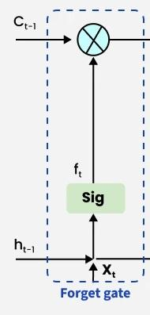
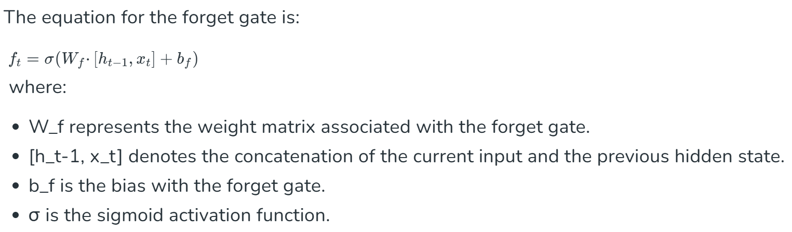
UNIT-4 LSTM Architecture:Forget Gate
The information that is no longer useful in the cell state is removed with the forget gate.
Two inputs x_{t} (input at the particular time) and h_{t-1} (previous cell output) are fed to the gate and multiplied with weight matrices followed by the addition of bias.
The resultant is passed through an activation function which gives a binary output. If for a particular cell state the output is 0, the piece of information is forgotten and for output 1, the information is retained for future use.

Slide 49
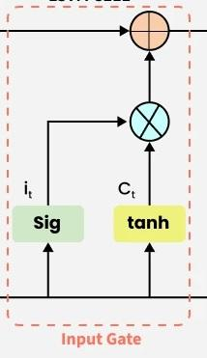
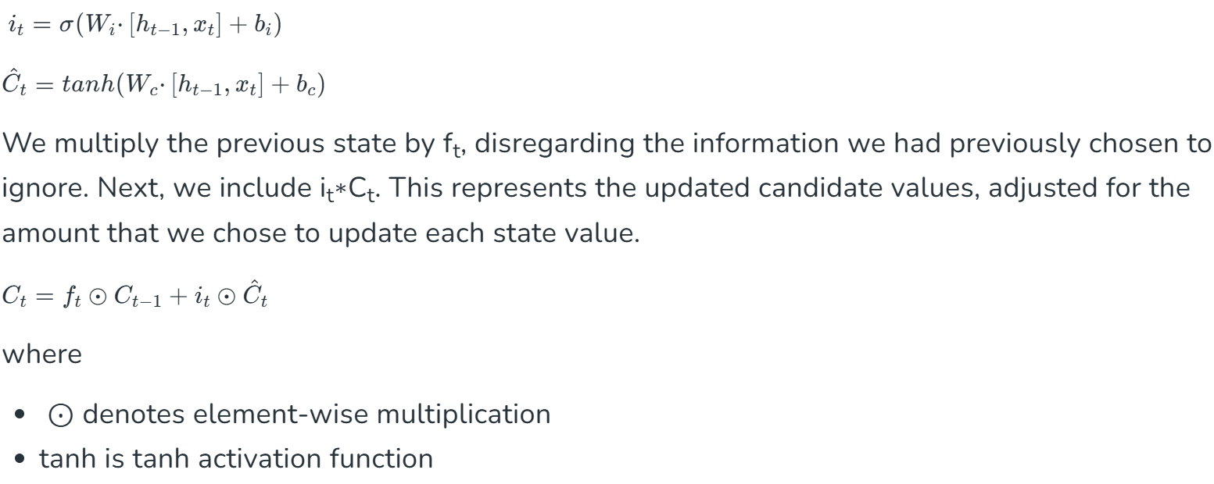
UNIT-4 LSTM Architecture:Input Gate
The addition of useful information to the cell state is done by the input gate.
First, the information is regulated using the sigmoid function and filter the values to be remembered similar to the forget gate using inputs h_{t-1} and x_{t.} .
Then, a vector is created using tanh function that gives an output from -1 to +1, which contains all the possible values from h_{t-1} and x_{t}. At last, the values of the vector and the regulated values are multiplied to obtain the useful information. The equation for the input gate is:

Slide 50
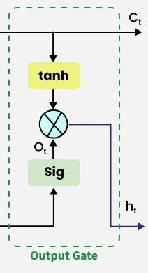
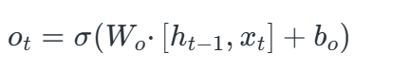
UNIT-4 LSTM Architecture:Output Gate
The task of extracting useful information from the current cell state to be presented as output is done by the output gate.
First, a vector is generated by applying tanh function on the cell. Then, the information is regulated using the sigmoid function and filter by the values to be remembered using inputs ht−1 ​and xt​.
At last, the values of the vector and the regulated values are multiplied to be sent as an output and input to the next cell. The equation for the output gate is:

Slide 51
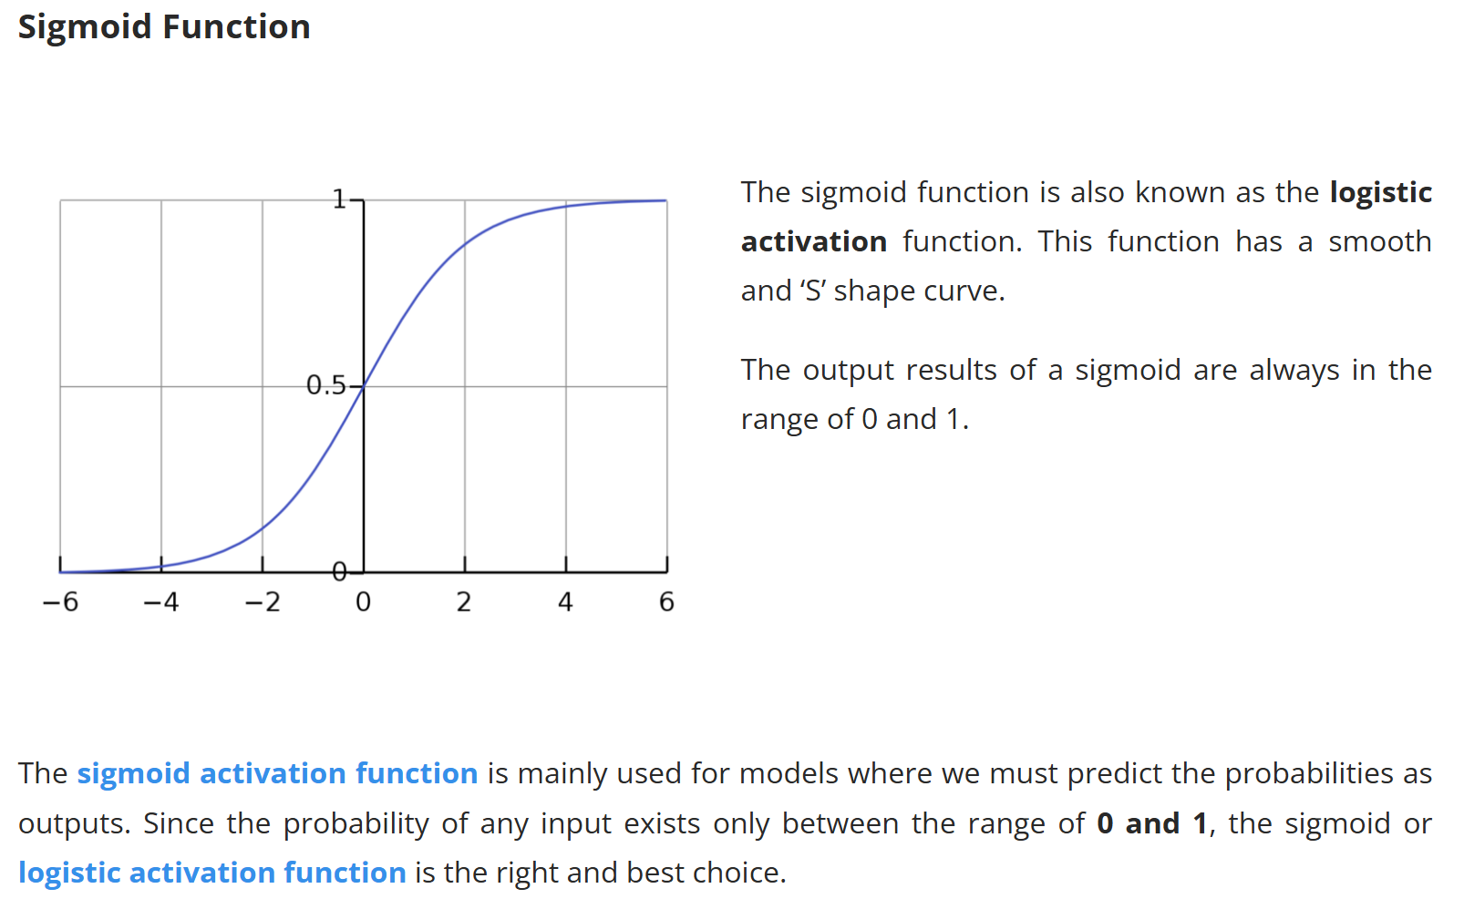
UNIT-4 Activation Functions used in LSTM

Slide 52
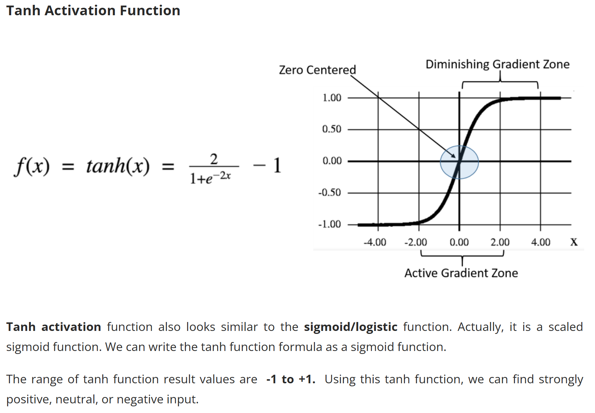
UNIT-4 Activation Functions used in LSTM

Slide 53
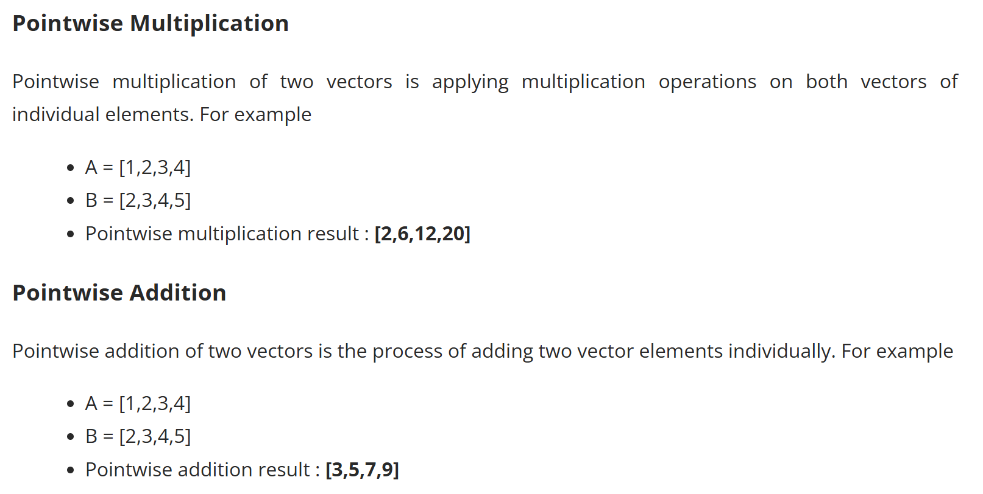
UNIT-4 Activation Functions used in LSTM

Slide 54
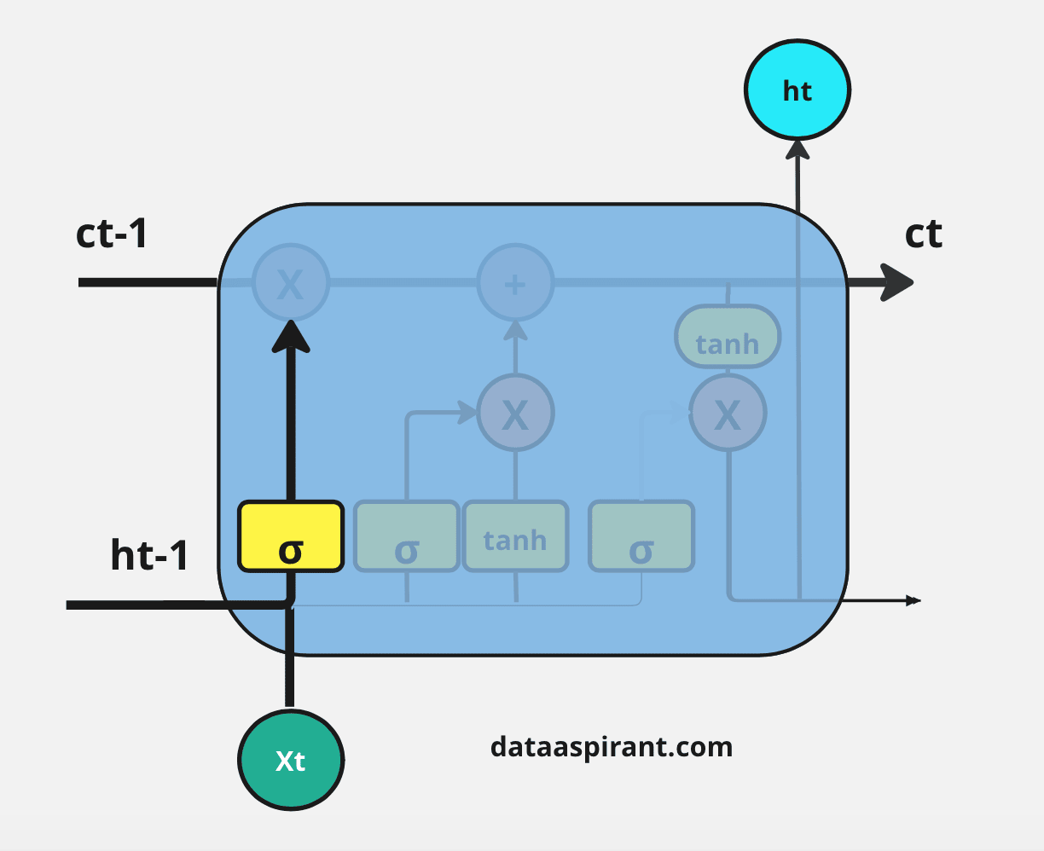
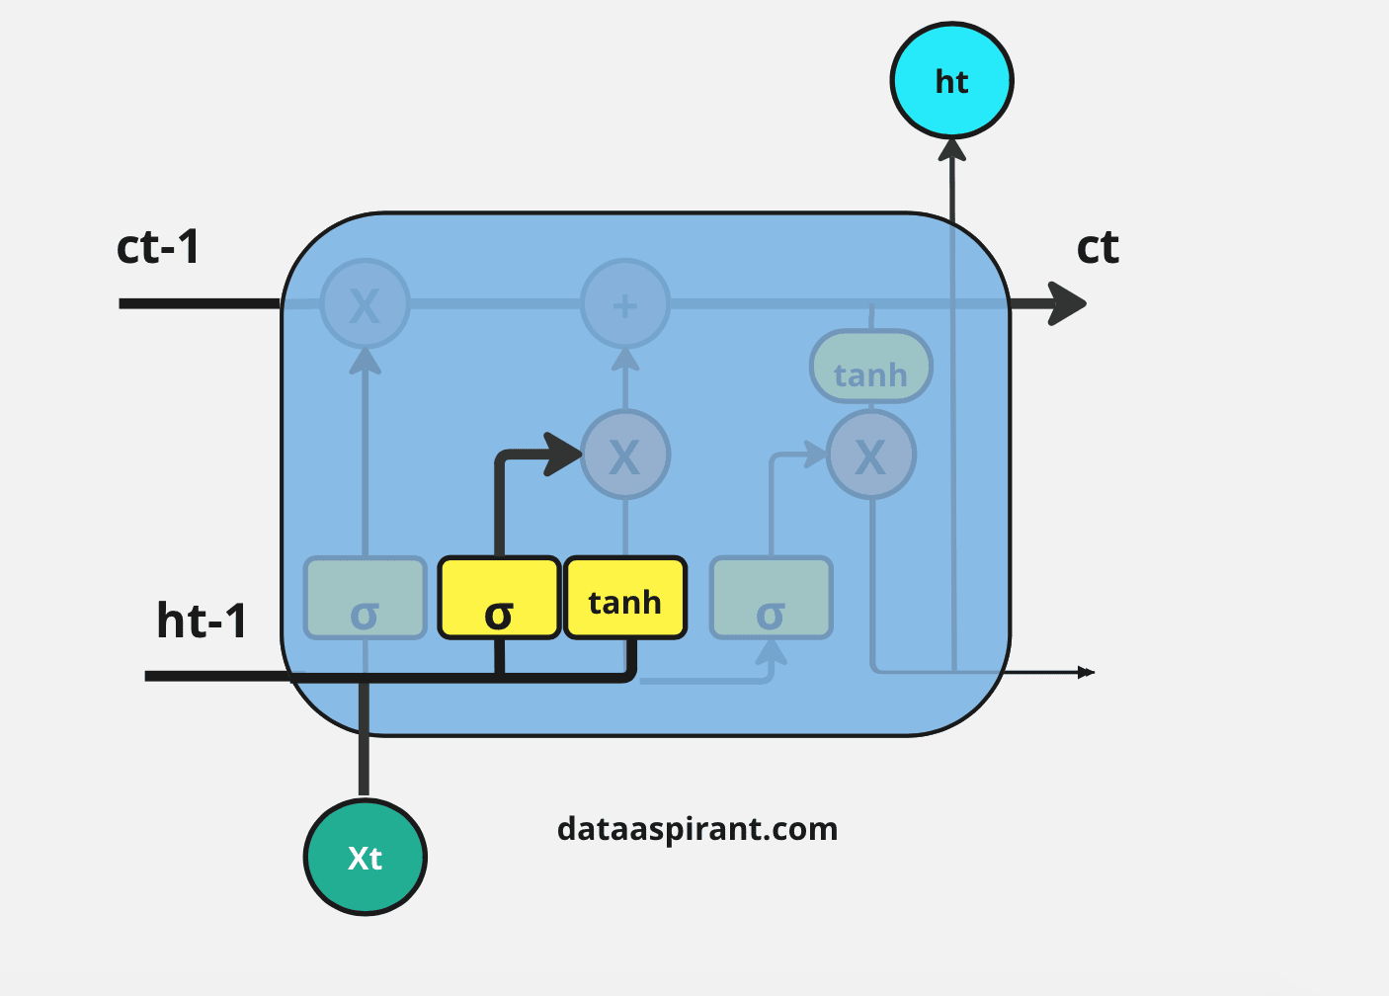
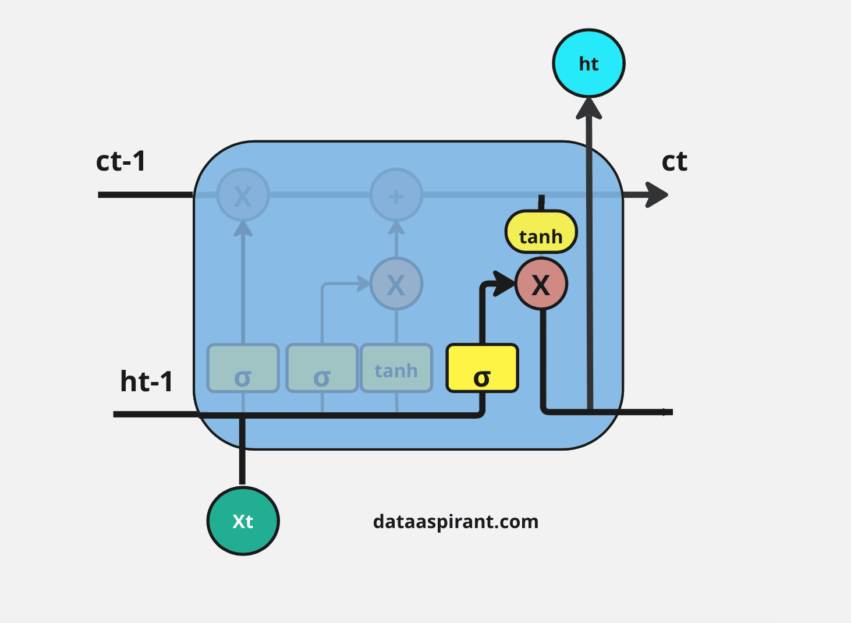
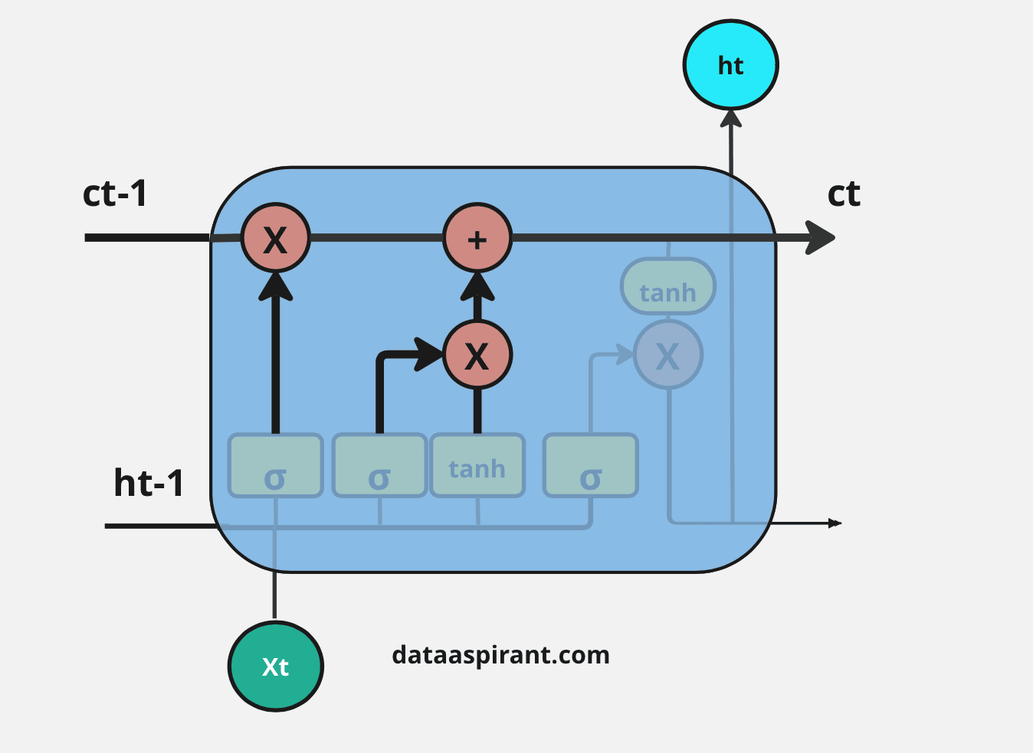
UNIT-4 Step-by-step Working Procedure of LSTM
https://dataaspirant.com/lstm-long-short-term-memory/

Slide 55

UNIT-4 Different Types of LSTM Architectures
https://dataaspirant.com/lstm-long-short-term-memory/

Slide 56
UNIT-4 Applications of LSTM
Some of the famous applications of LSTM includes:
Language Modeling: Used in tasks like language modeling, machine translation and text summarization. These networks learn the dependencies between words in a sentence to generate coherent and grammatically correct sentences.
Speech Recognition: Used in transcribing speech to text and recognizing spoken commands. By learning speech patterns they can match spoken words to corresponding text.
Time Series Forecasting: Used for predicting stock prices, weather and energy consumption. They learn patterns in time series data to predict future events.
Anomaly Detection: Used for detecting fraud or network intrusions. These networks can identify patterns in data that deviate drastically and flag them as potential anomalies.
Recommender Systems: In recommendation tasks like suggesting movies, music and books. They learn user behavior patterns to provide personalized suggestions.
Video Analysis: Applied in tasks such as object detection, activity recognition and action classification. When combined with Convolutional Neural Networks (CNNs) they help analyze video data and extract useful information.

Slide 57
UNIT-4 Gated Recurrent Unit (GRU),
Recurrent Neural Networks (RNNs) are widely used in machine learning for sequential data tasks such as:
Text processing
Speech recognition
Time-series analysis
Traditional RNNs face difficulty in capturing long-term dependencies due to the vanishing gradient problem.
Long Short-Term Memory (LSTM) networks were introduced to address this issue by maintaining long-term memory through gated mechanisms.
However, LSTMs have:
A complex structure
Higher computational cost
To improve efficiency, the Gated Recurrent Unit (GRU) was introduced.
GRUs simplify the LSTM architecture by:
Merging gates
Offering comparable performance on many tasks
Reducing computational complexity
GRUs are effective for many sequential tasks without sacrificing model accuracy.

Slide 58

UNIT-4 Gated Recurrent Unit (GRU),

Slide 59

UNIT-4 Gated Recurrent Unit (GRU),

Slide 60

UNIT-4 Gated Recurrent Unit (GRU),
The GRU consists of two main gates:
Update Gate (zt​): This gate decides how much information from previous hidden state should be retained for the next time step.
Reset Gate (rt): This gate determines how much of the past hidden state should be forgotten.
These gates allow GRU to control the flow of information in a more efficient manner compared to traditional RNNs which solely rely on hidden state.
https://d2l.ai/chapter_recurrent-modern/gru.html

Slide 61


UNIT-4 Equations for GRU Operations

Slide 62

UNIT-4 Equations for GRU Operations

Slide 63

UNIT-4 How GRUs Solve the Vanishing Gradient Problem

Slide 64

UNIT-4 How GRUs Solve the Vanishing Gradient Problem

Slide 65

UNIT-4 GRU vs. LSTM

Slide 66

UNIT-4 GRU vs. LSTM

Slide 67

UNIT-4 GRU vs. LSTM

Slide 68

UNIT-4 GRU vs. LSTM

Slide 69
UNIT-4 Bidirectional RNN
A Bidirectional Recurrent Neural Network (BRNN) is an extension of traditional RNNs designed to process sequential data in both forward and backward directions.
This enables the network to utilize both past and future context when making predictions.
It works like normal RNN by moving in forward direction, updating the hidden state depending on the current input and the prior hidden state at each time step.
The backward hidden layer on the other hand analyses the input sequence in the opposite manner, updating the hidden state based on the current input and the hidden state of the next time step.
Compared to conventional unidirectional recurrent neural networks the accuracy of BRNN is improved since it can process information in both directions and account for both past and future contexts.
Because the two hidden layers can complement one another and predictions are made based on the combined outputs of the two hidden layers. layers.

Slide 70

UNIT-4 Bidirectional RNN

Slide 71

UNIT-4 Bidirectional RNN

Slide 72

UNIT-4 Bidirectional RNN

Slide 73
UNIT-4 Need for Bi-directional RNNs
A uni-directional recurrent neural network (RNN) processes input sequences in a single direction, either from left to right or right to left.
This means the network can only use information from earlier time steps when making predictions at later time steps.
This can be limiting, as the network may not capture important contextual information relevant to the output prediction.
For example, in natural language processing tasks, a uni-directional RNN may not accurately predict the next word in a sentence if the previous words provide important context for the current word.
Consider an example where we could use the recurrent network to predict the masked word in a sentence.
Apple is my favorite _____.
Apple is my favourite _____, and I work there.
Apple is my favorite _____, and I am going to buy one.

Slide 74
UNIT-4 Need for Bi-directional RNNs
Consider an example where we could use the recurrent network to predict the masked word in a sentence.
Apple is my favorite _____.
Apple is my favourite _____, and I work there.
Apple is my favorite _____, and I am going to buy one.
In the first sentence, the answer could be fruit, company, or phone. But it can not be a fruit in the second and third sentences.
A Recurrent Neural Network that can only process the inputs from left to right may not accurately predict the right answer for sentences discussed above.
To perform well on natural language tasks, the model must be able to process the sequence in both directions.

Slide 75

UNIT-4 BRNN vs. RNN

Slide 76
UNIT-4 Advantages and Challenges BRNN
Advantages of BRNNs
Enhanced context understanding: Uses both past and future data for better predictions.
Improved accuracy: Useful in NLP and speech processing tasks.
Better handling of variable-length sequences: More flexible compared to standard RNNs.
Increased robustness: Can mitigate noise and irrelevant information due to forward and backward processing.
Challenges of BRNNs
High computational cost: Requires twice processing compared to unidirectional RNNs.
Longer training time: More parameters to optimize making convergence slow.
Limited real-time applicability: Since they require entire sequence before making predictions they are not ideal for real-time applications like live speech recognition.
Less interpretability: Understanding why a prediction was made is more complex than a standard RNN.

Slide 77

UNIT-4 Deep Recurrent Neural Network

Slide 78

UNIT-4 Deep Recurrent Neural Network

Slide 79

UNIT-4 Deep Recurrent Neural Network

Slide 80

UNIT-4 Deep Recurrent Neural Network
https://medium.com/@abhishekjainindore24/deep-rnns-stacked-rnns-stacked-lstms-79cf652f451a

Slide 81

UNIT-4 Basic Components of Deep RNN Architecture

Slide 82

UNIT-4 Basic Components of Deep RNN Architecture

Slide 83

UNIT-4 Basic Components of Deep RNN Architecture

Slide 84
UNIT-4 Deep RNN
Why use sequence models?
Recurrent Neural Network Model,
Notation,
Back-propagation through time (BTT),
Different types of RNNs,
Language model and sequence generation,
Sampling novel sequences,
Vanishing gradients with RNNs,
Gated Recurrent Unit (GRU),
Long Short-Term Memory (LSTM),
Bidirectional RNN,
Deep RNNs

